Slide 1
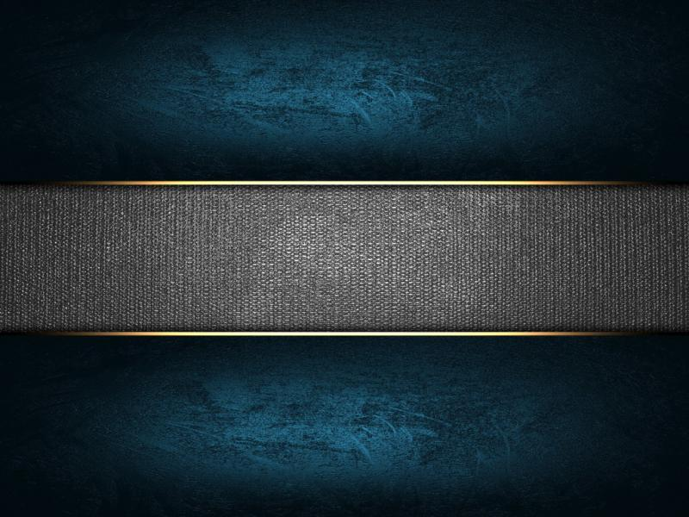
SECURED MESSAGE TRANSFERER
· Rishabanath K
· Rahul B
· Sai Santhosh S

Slide 2
INTRODUCTION
In this project, our team used a PIC microcontroller to create “Secured Message Transferer”
(i.e) Morse Code.
Morse code is a method used in telecommunication to encode text characters as standardized sequences of two different signal durations, called dots and dashes, or dits and dahs.
We have made the process easier by programming a PIC microcontroller to do the conversion of the alphabet to Morse code and displaying it using an LED light.
It displays the code’s output analog values and the LEDs glow accordingly to the alphabets.

Slide 3
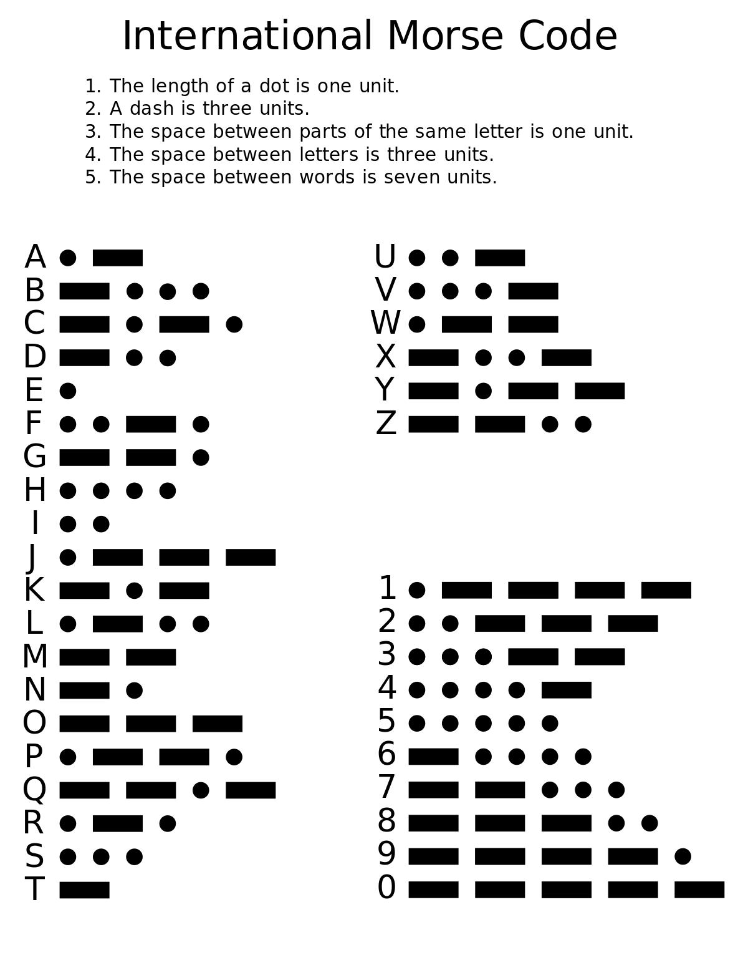

Slide 4
COMPONENTS & SOFTWARE REQUIRED
PIC microcontroller - PIC16F877A IC
LED light
Resistors - 470 ohms
Capacitors - 22pF
Crystal oscillator - 8MHz
Breadboard
Connecting Wires
Female and Male Jumper wires
IC 7805
9V Battery
MPLAB software
Proteus Software

Slide 5
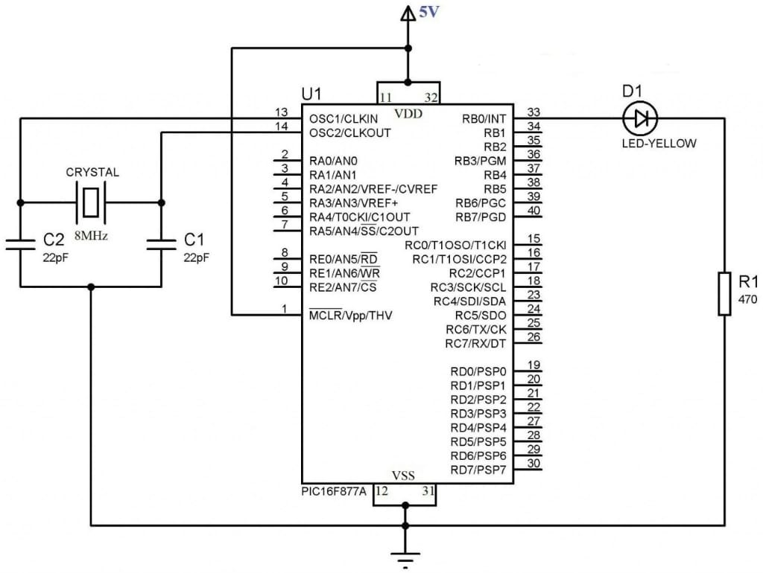
CIRCUIT DESIGN

Slide 6
COMPONENTS
PIC 16f877A:
PIC is a family of microcontrollers made by Microchip Technology. The name PIC initially referred to "Peripheral Interface Controller”, and is currently expanded as "Programmable Intelligent Computer”. Data memory is 8-bit, 16-bit, and, in the latest models, 32-bit wide. Program instructions vary in bit-count by the family of PIC and maybe 12, 14, 16, or 24 bits long. The instruction set also varies by model, with more powerful chips adding instructions for digital signal processing functions.One of the main advantages is that it can be write-erase as many times as possible because it uses FLASH memory technology.
It has a total number of 40 pins and there are 33 pins for input and output. PIC16f877a finds its applications in a huge number of devices. It is used in remote sensors, security and safety devices, home automation and many industrial instruments. An EEPROM is also featured in it which makes it possible to store some of the information permanently like transmitter codes and receiver frequencies and some other related data. The cost of this controller is low and its handling is also easy.
It is flexible and can be used in areas where microcontrollers have never been used before as in microprocessor applications and timer functions etc.

Slide 7
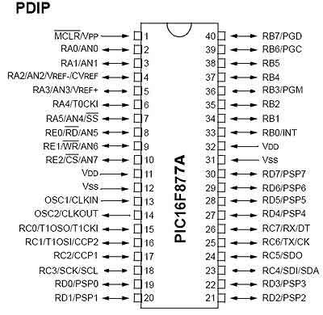

Slide 8
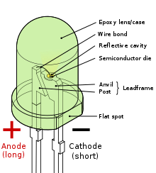
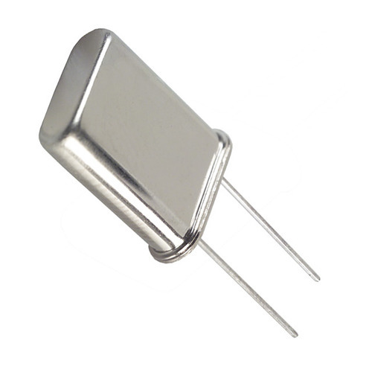
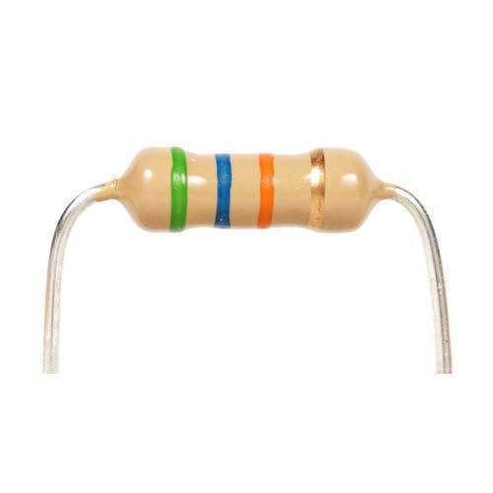
LED:
A light-emitting diode (LED) is a semiconductor light source that emits light when current flows through it. The colour of the light (corresponding to the energy of the photons) is determined by the energy required for electrons to cross the band gap of the semiconductor. The material used most often in LEDs is gallium arsenide, though there are many variations on this basic compound, such as aluminium gallium arsenide or aluminium gallium indium phosphide.
CRYSTAL OSCILLATOR:
A crystal oscillator is an electronic oscillator circuit that uses the mechanical resonance of a vibrating crystal of piezoelectric material to create an electrical signal with a constant frequency. They are used to provide clock to the microcontroller.
RESISTORS:
A passive two-terminal electrical component that implements electrical resistance as a circuit element. In electronic circuits, resistors are used to reduce current flow, adjust signal levels, to divide voltages, bias active elements, and terminate transmission lines, among
other uses.

Slide 9
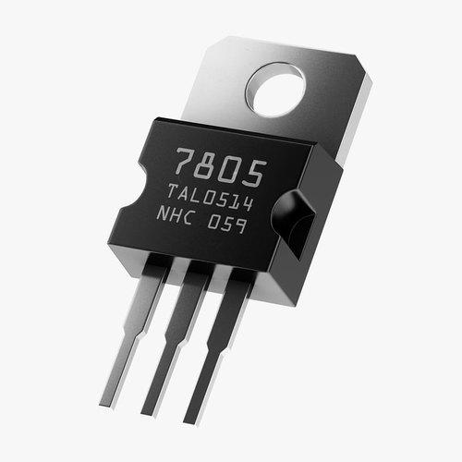
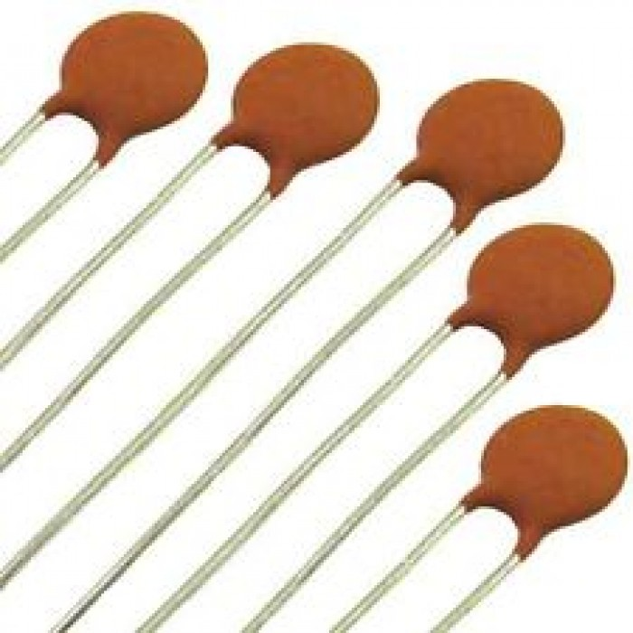
IC 7805 VOLTAGE REGULATOR:
A 7805 Voltage Regulator IC is a commonly used voltage regulator. They provide a constant output voltage for a varied input voltage. The name 7805 signifies two meaning, “78” means that it is a positive voltage regulator and “05” means that it provides 5V as output. So the 7805 will provide a +5V output voltage to the circuit.
CAPACITORS:
A capacitor is a device that stores electrical energy in an electric field. It is a passive electronic component with two terminals. The effect of a capacitor is known as capacitance.

Slide 10

OUTPUT

Slide 11
EXPLANATION
As shown in the diagram, set the RC0 pin as a digital output pin.
Each letter has a morse code for it.
The morse code has 2 different parts dot and dash, they are differentiated with the delay function where dot has less time delay and dash has longer time delay RC0 pin high.
Each element is differentiated with RC0 pin low and each letter is differentiated with longer delay RC0 pin low.
In the program the input is hard coded where the input is given as “rahul”, its morse code is “._. ._ .... .._ ._..”, this is depicted using the LED light.

Slide 12
APPLICATIONS
Morse code can be applied to a flashlight (just key it using a switch) and you can communicate this way much further than when using your voice.
Morse code is still used by some people to send the distress signals, extensively used in military applications and many more aviation submarines even by Government applications.
It is still in use by naval and amateur radio operators.
In aviation, pilots use radio navigation aids. To ensure that the stations the pilots are using are serviceable, the stations transmit a set of identification letters (usually a two-to-five-letter version of the station name) in Morse code.
Morse code is also helping people with disabilities like deafness, blindness, dumbness and motion disability, to communicate.

Slide 13
ADVANTAGES
Use of the Morse code is a cheaper way to send information over long distances.
Wireless.The lack of wires has made the application of Morse code diverse since it is silently sent and received at any desirable speed.
It greatly improved the speed of communication.
Our project is likely to give 91% of the efficiency that it could have achieved with the same codes. This is relative to Google's English corpus. A different corpus would give slightly different results. ... By that measure Morse code is about 93.5% efficient.

Slide 14
DISADVANTAGES
Learning the Morse Code. The Morse code is not an easy concept to understand and it is largely a reserve of a few radio programmers.
The Morse code is easy to intercept.
Sending and decoding of the Morse code is time consuming.

Slide 15


